Slide 1

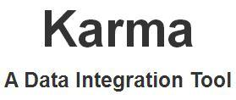
Karma is a Tool! prepared for VIVO Camp
Violeta Ilik
Galter Health Sciences Library
Feinberg School of Medicine
Northwestern University Clinical and Translational Sciences Institute (NUCATS), Chicago, IL
Albuquerque, NM – April 6-8, 2017

Slide 2
Outline:
Examine your data
Clean your data
Create local ontology extensions (optional)
Model your data
Load your data
Violeta Ilik @violetailik

Slide 3
Examine your data
Accommodate within existing ontologies most of your data
Opt for local extensions if necessary
Local unique identifiers (people & organizations)
Specific needs (publication types; non-traditional scholarly outputs …)
Violeta Ilik @violetailik

Slide 4
Clean your data
Utilizing local resources and skills
- polyglot programing skills (Python, Perl, XSLT, SAS, R, OpenRefine)
Violeta Ilik @violetailik

Slide 5
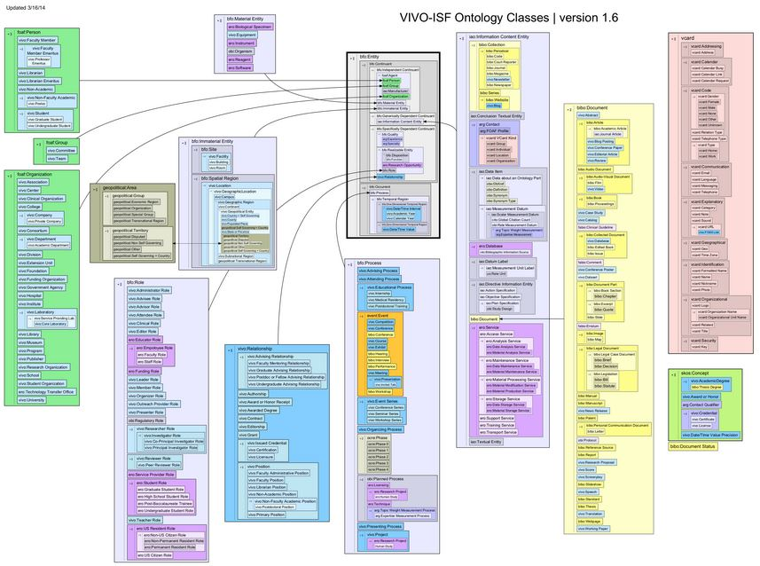
Ontology: VIVO-ISF
Violeta Ilik @violetailik

Slide 6
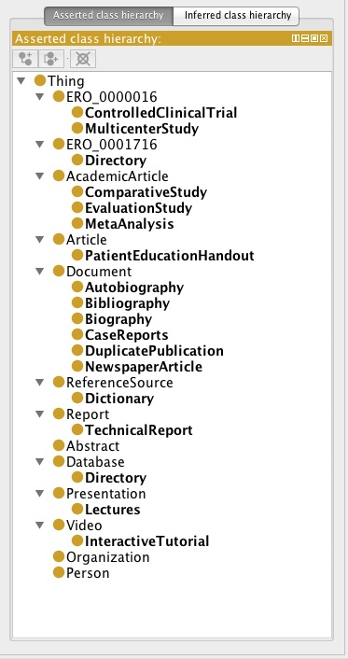
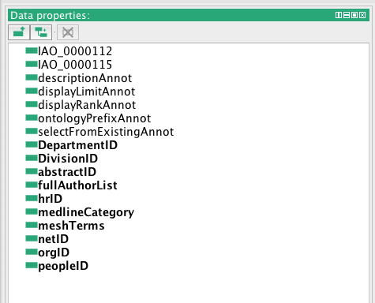
Ontology: local extensions
Violeta Ilik @violetailik

Slide 7
Karma enables integration of:
CSV/TSV files
XML
JSON
Databases
KML
Web APIs
Violeta Ilik @violetailik

Slide 8
The modeling consists of four steps:
Assign Semantic Types
Constructing the Graph
Refine Source Model
Generate Formal Specification
Violeta Ilik @violetailik
Notes:
First step which involves mapping of each column of a source to a node in the ontology. The previously learned semantic types are easily recognized by the tool. If the offered semantic type is incorrect the user can select from the menu the correct node in the graph/ontology.
Second step involves defining the space of all possible mappings between the source and the ontology. At a high level the nodes in the graph represent classes in the ontology and the edges represent properties that relate these classes.”
Third step allows for updating the graph to refine the model based on user input.
Fourth step allows for generating a source model that can be saved for future use and applied to data sources that user wishes to model to the same semantic types.

Slide 9

Result
Violeta Ilik @violetailik

Slide 10
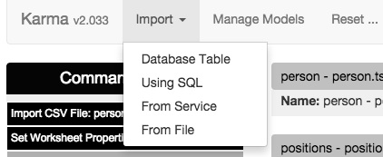
Karma Import options:
Violeta Ilik @violetailik

Slide 11
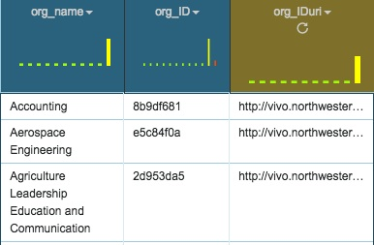
Importing CSV/TSV files
Violeta Ilik @violetailik

Slide 12
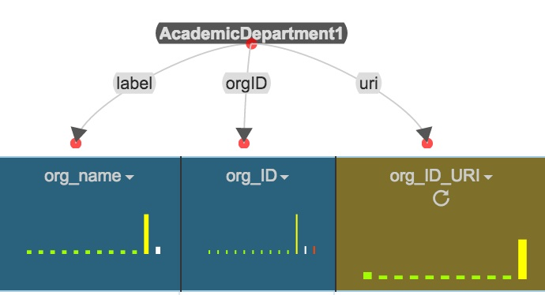
Modeling organizations/units data
Violeta Ilik @violetailik

Slide 13
R2RML - RDB to RDF Mapping Language
“R2RML, a language for expressing customized mappings from relational databases to RDF datasets. Such mappings provide the ability to view existing relational data in the RDF data model, expressed in a structure and target vocabulary of the mapping author's choice. R2RML mappings are themselves RDF graphs and written down in Turtle syntax. R2RML enables different types of mapping implementations. Processors could, for example, offer a virtual SPARQL endpoint over the mapped relational data, or generate RDF dumps, or offer a Linked Data interface.”
http://www.w3.org/TR/r2rml/
Violeta Ilik @violetailik

Slide 14
R2RML
_:node19s213a13x1 a km-dev:R2RMLMapping ;
km-dev:sourceName "organisations - organisations.tsv" ;
km-dev:modelPublicationTime "1438882310179"^^xsd:long ;
km-dev:modelVersion "1.7" ;
km-dev:hasInputColumns "[[{\"columnName\":\"org_name\"}],[{\"columnName\":\"org_ID\"}]]" ;
km-dev:hasOutputColumns "[[{\"columnName\":\"org_name\"}],[{\"columnName\":\"org_IDuri\"}],[{\"columnName\":\"org_ID\"}]]" ;
km-dev:hasModelLabel "organisations - organisations.tsv" ;
km-dev:hasBaseURI "http://localhost:8080/source/" ;
km-dev:hasWorksheetHistory """[
{
\"commandName\": \"SetSemanticTypeCommand\",
\"inputParameters\": [
{
\"name\": \"hNodeId\",
\"type\": \"hNodeId\",
\"value\": [{\"columnName\": \"org_name\"}]
},
{
\"name\": \"worksheetId\",
\"type\": \"worksheetId\",
\"value\": \"W\"
},
{
\"name\": \"selectionName\",
\"type\": \"other\",
\"value\": \"DEFAULT_TEST\"
},
{
\"name\": \"SemanticTypesArray\",
\"type\": \"other\",
\"value\": [{
\"DomainUri\": \"http://vivoweb.org/ontology/core#AcademicDepartment\",
\"DomainId\": \"http://vivoweb.org/ontology/core#AcademicDepartment1\",
\"isPrimary\": true,
\"FullType\": \"http://www.w3.org/2000/01/rdf-schema#label\",
\"DomainLabel\": \"vivo:AcademicDepartment1 (add)\"
Violeta Ilik @violetailik

Slide 15
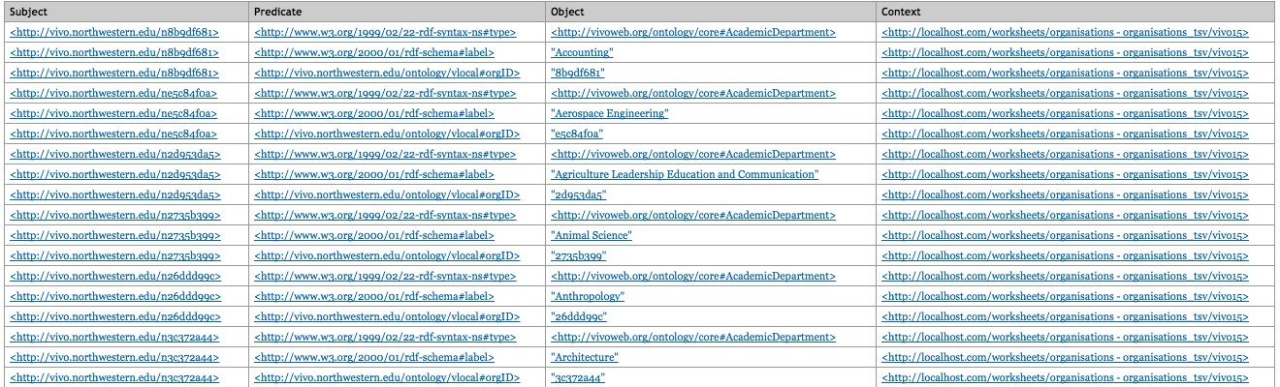
Workbench: organizations/units N-Triples
Violeta Ilik @violetailik

Slide 16
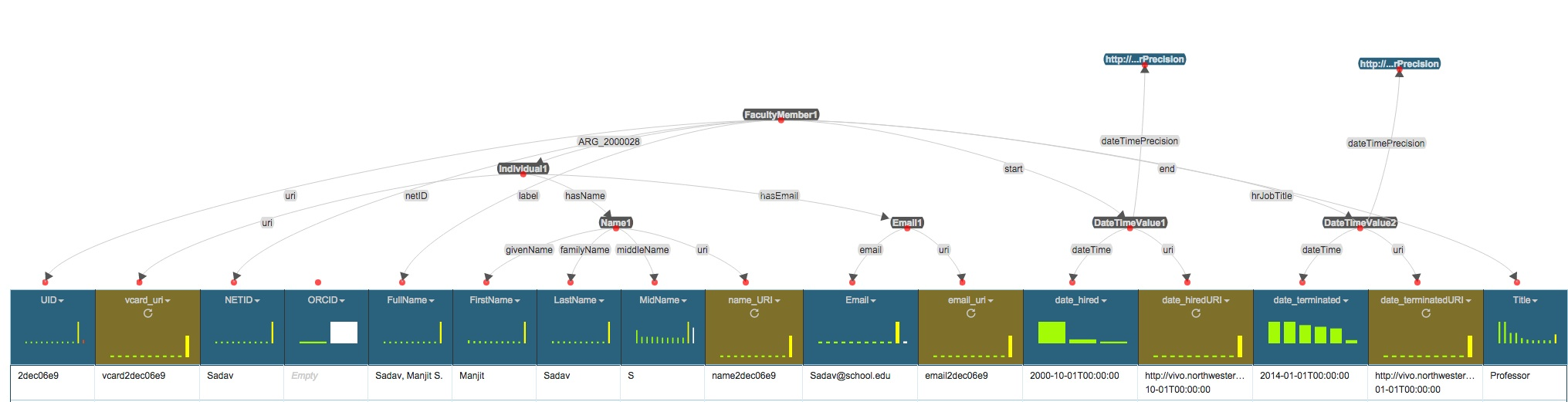
Modeling the person file
Violeta Ilik @violetailik

Slide 17
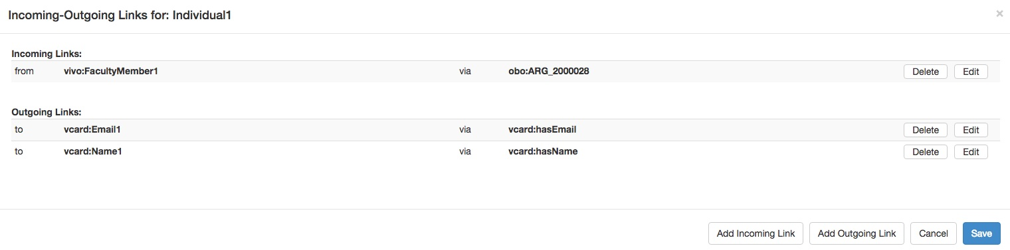
Incoming-Outgoing links: Individual
Violeta Ilik @violetailik

Slide 18
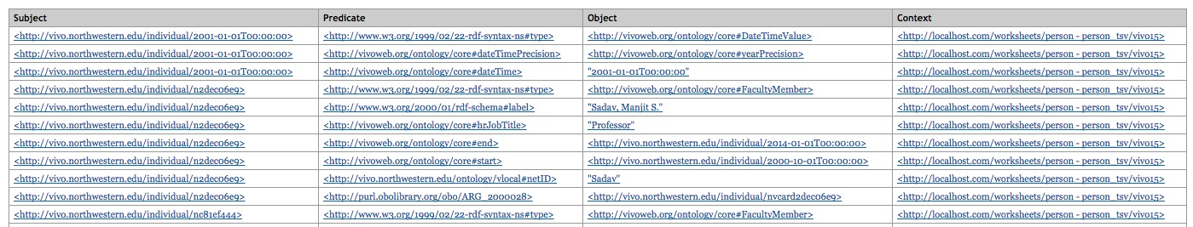
Workbench: person N-Triples
Violeta Ilik @violetailik

Slide 19
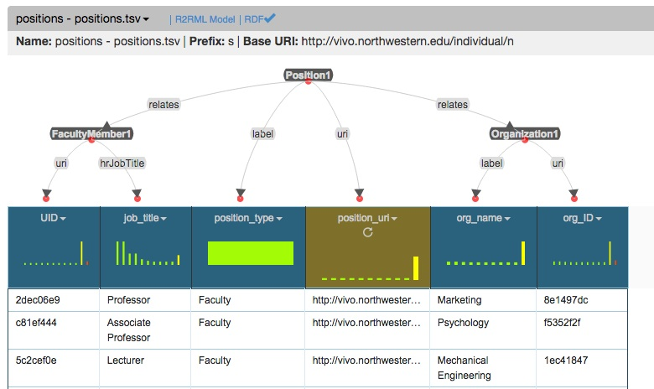
Modeling the position file
Violeta Ilik @violetailik

Slide 20
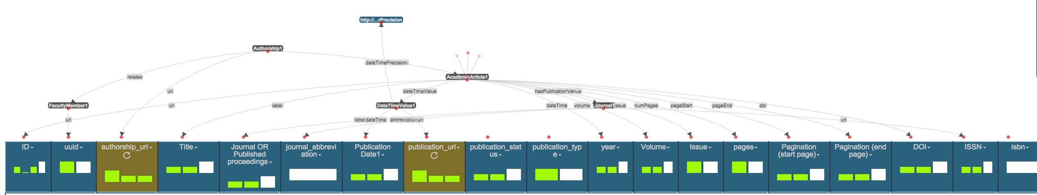
Modeling publications data- academic articles
Violeta Ilik @violetailik

Slide 21
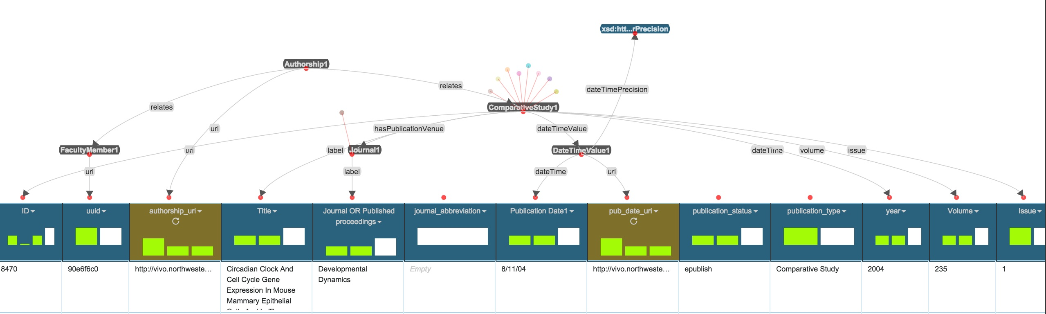
Modeling publications data – comparative study
Violeta Ilik @violetailik

Slide 22
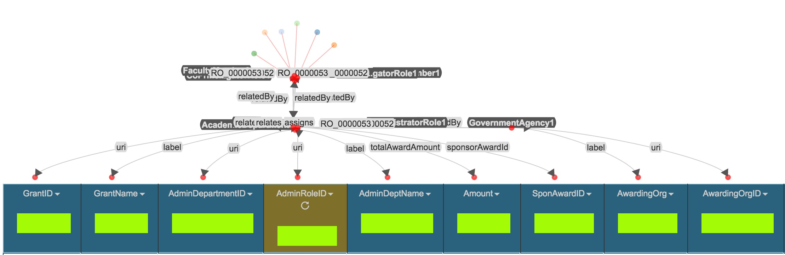
Modeling grants data
Violeta Ilik @violetailik

Slide 23
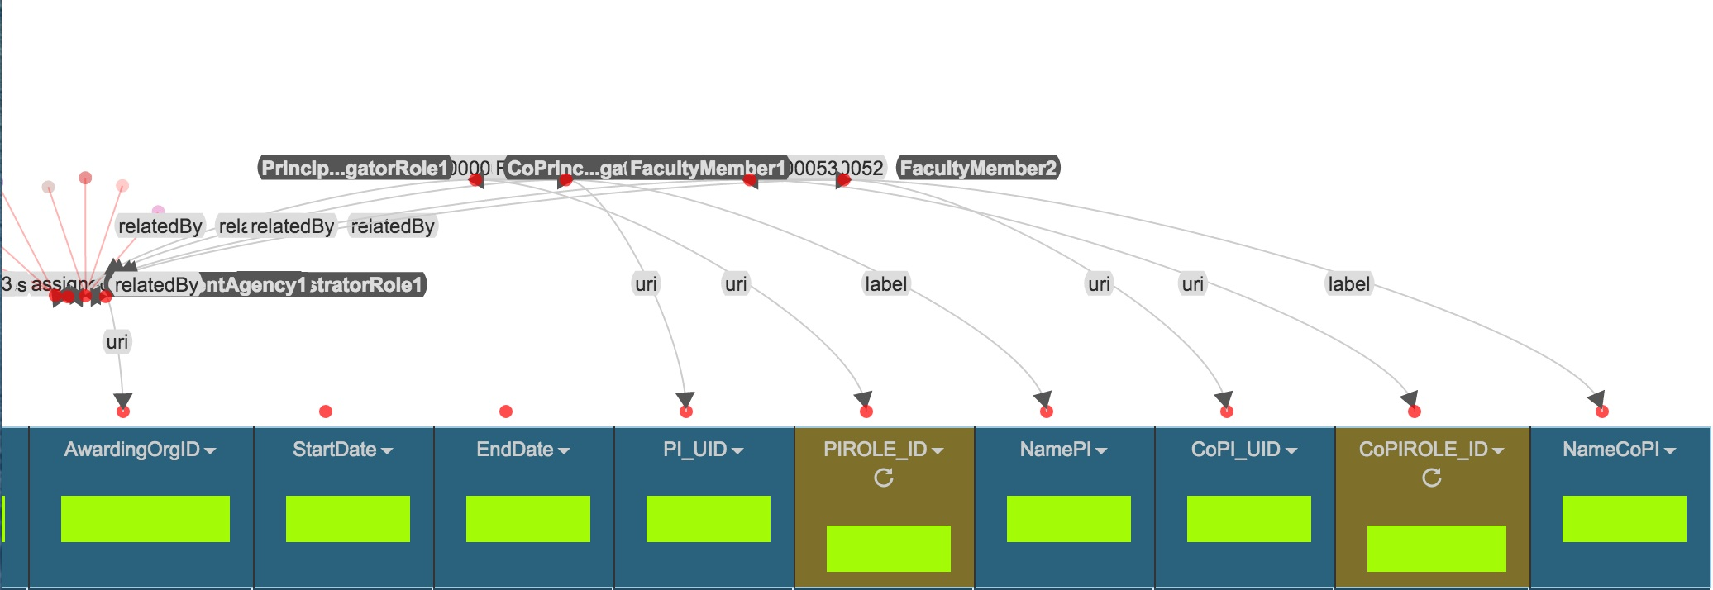
Modeling grants data - continued
Violeta Ilik @violetailik

Slide 24
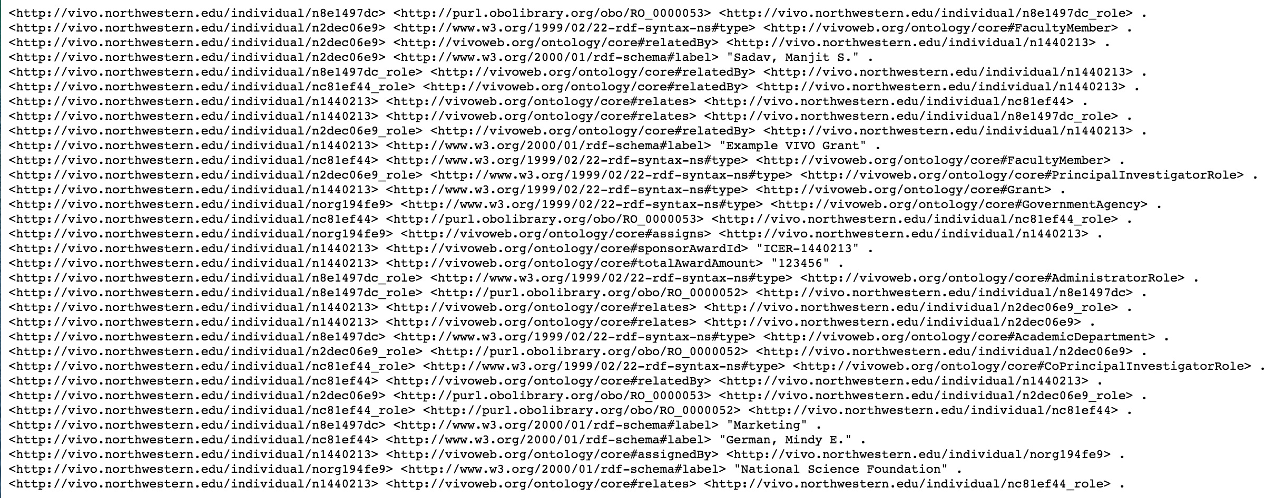
Modeling grants data - RDF
Violeta Ilik @violetailik

Slide 25
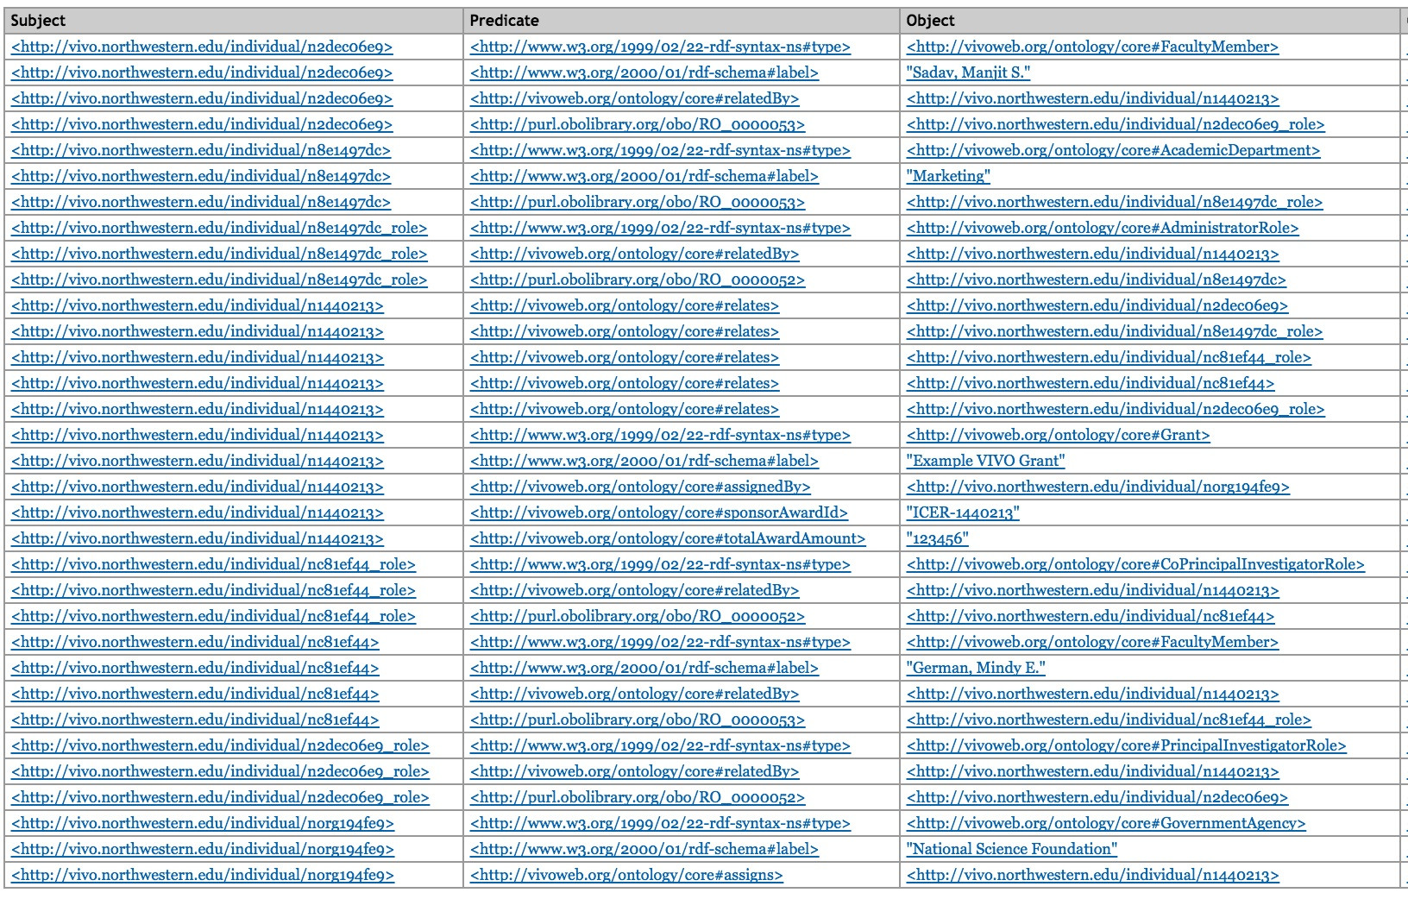
Workbench: grants N-Triples
Violeta Ilik @violetailik

Slide 26
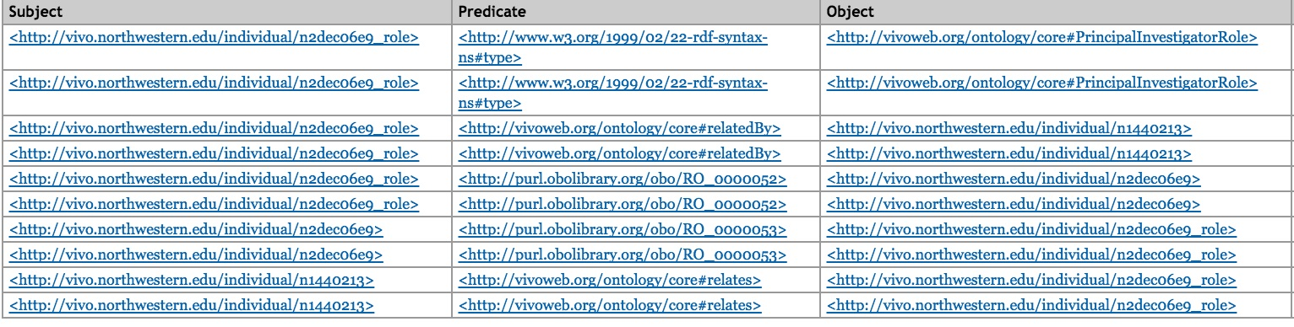
Workbench: PI role N-Triples
Violeta Ilik @violetailik

Slide 27
References:
https://github.com/vioil/ontology_extensions
https://github.com/vioil/DataPropeties-id
https://github.com/vioil/R2RML-Karma
https://www.youtube.com/channel/UCb9vsw2XvZDzZtEwe0aH9eA
http://www.isi.edu/integration/karma/
Violeta Ilik @violetailik

Slide 28
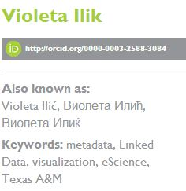
Thank you Violeta Ilik Galter Health Sciences Library Feinberg School of Medicine Northwestern University Clinical and Translational Sciences Institute (NUCATS), Chicago, IL https://galter.northwestern.edu/staff/Violeta-Ilik http://vivo.vivoweb.org/display/n10603
Violeta Ilik @violetailik

